Slide 1
WASTE IDENTIFIER
UMANG GUPTA
SARTHAK JAIN
TANMAY JAIN
PRIYANSHU PATHAK

Slide 2
Concept & Benefits
Waste identifier is a tool that is able to identify the waste and help in segregating waste.
The Waste identifier will work on CNN Architecture, Deep learning algorithms , keras and tesorflow libaray , Neural Network Analysis and Flask API.
e.g. if we have plastic polythene in our hand then the waste identifier will identify it and predict the type of waste and shown whether its recyclable or not.
By introducing this idea in waste processing plant, the manual segregation process will be replaced and hence less human exposure to the waste

Slide 3
How To Run Our Project
Install the Necessary Requirements and Run app.py file using "python app.py" command on the terminal
Copy the resulting link or address from the terminal and run into the browser of your choice.
select file which you want to categorise or segregate.
The category of image is shown as the output.

Slide 4
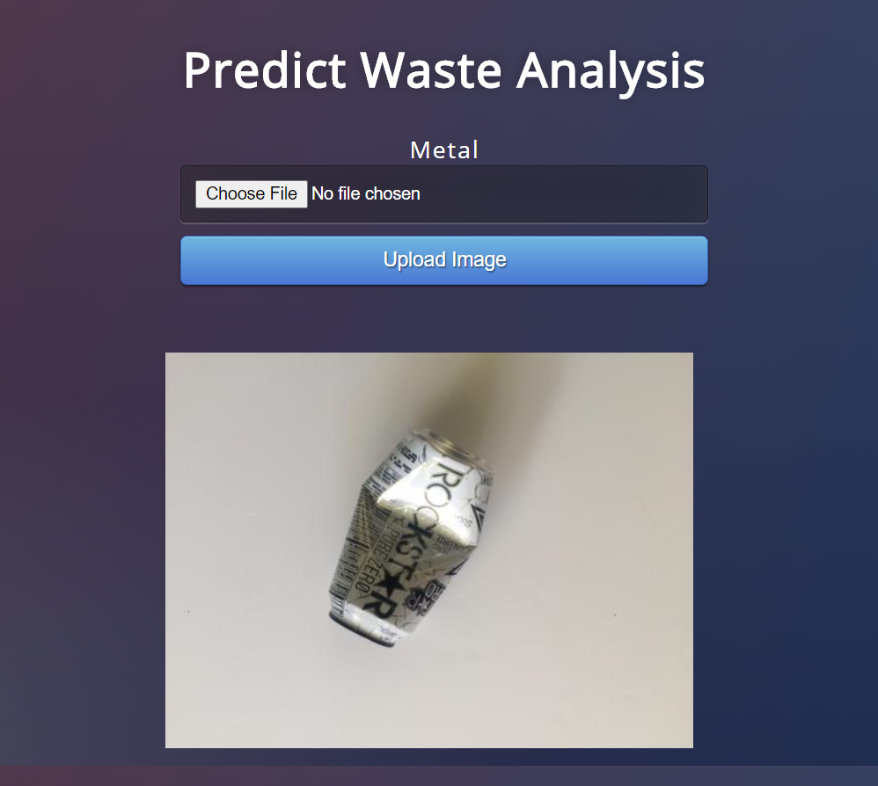
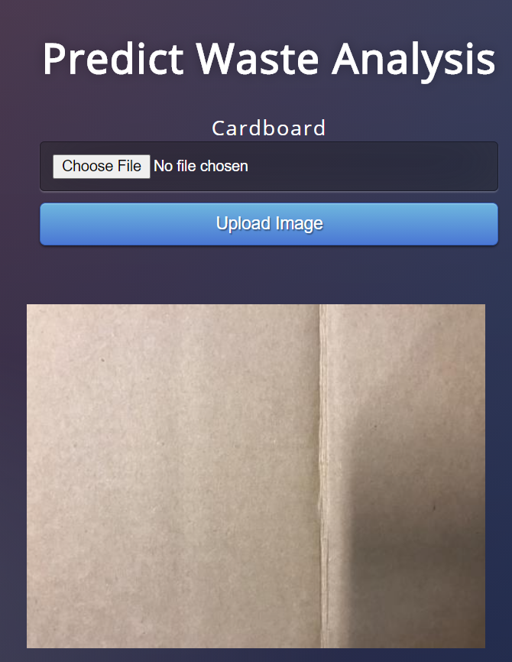
WASTE IDENTIFIER INTERFACE

Slide 5
Thank You

